Slide 1
Students Grievance Support System
OJASS'21
Hack de science 2021~ Nit jamshedpur

Slide 2
IDEA
Problem Statement
An easy access application, accessible to students, members of Student Grievance Redressal Committees, respective heads.
Students should be able to post complaints under different categories:-
Department Level, Institute/College Level and University Level. Again these categories would be subdivided among sub categories such as Admission, Finance, Examination, Lecture Timetable/Learning, Paper Re-Evaluation, etc.
WE HAVE PLANNED TO CREATE AND ANDROID APPLICATION WHICH OPENS WITH A PAGE GIVING THE LOGIN OPTIONS AS STUDENT AND FOR MEMBERS WHICH WILL REDIRECT THEM TO THEIR RESPECTIVE PROFILE PAGE.
THERE THEY WILL GET SOME NAVIGATION OPTION LIKE NEW COMPLAIN , MY COMPLAINS,TRACK A COMPLAIN ,REPORT TO ANTI-RAGING CELL AND CONSULT A PSYCHIATRIST. AND THE MEMBERS WILL EASILY BE ABLE TO LOGIN WITH THEIR CREDENTIALS AND CAN SEARCH THE COMPLIANS.

Slide 3
Application- Saath
FrontEnd- XML
BackEnd- Java, SQLite
Platform- Android Studio
Team Sinaloa
2020
Vibhu Pandey (ECE 068)
Subhadip Das (EE 055)

Slide 4
Main Activity
Login Activities
Home Page
New Complain
My Complains
Track Complain
Anti Ragging Cell
Consult a Psychiatrist

Slide 5
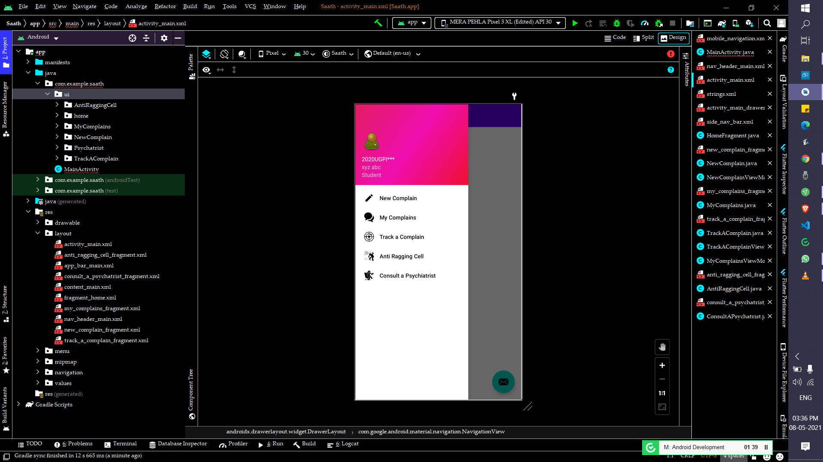
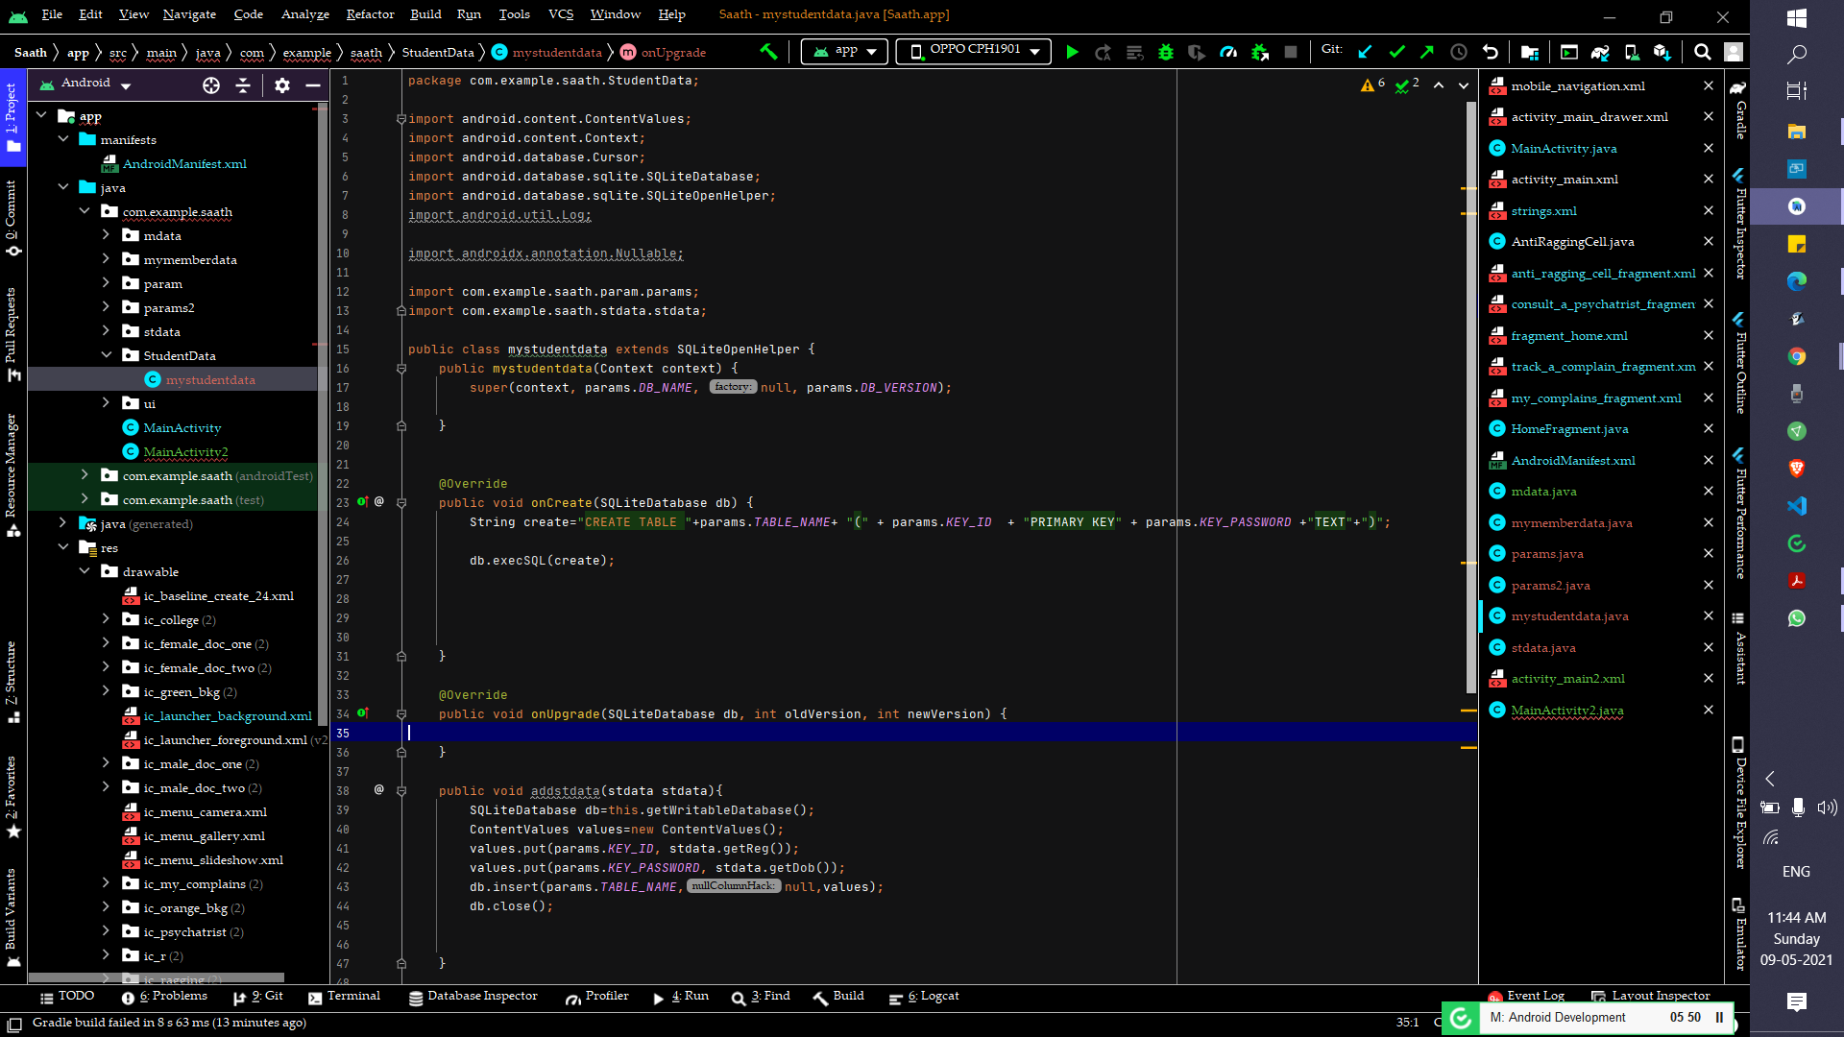
First look
Connecting SQLite

